Slide 1

[ACBSD-3265] [Intercom equipment installation in AUK]
Exception for Design pattern: New Office Experience ACBSD-3160
[Mohamed Kerbachi]
06/30/2025

Slide 2
Version Control
Version | Date | Author | Description
1.0 | 06/04/2025 | Mohamed Kerbachi | Intercom wired connection in UK offices

Slide 3
Design Pattern Description
Overview
This is the architecture pattern for integrating third-party Intercom provider in UK Datacenter Edinburgh and Witham
Key Use Case Considerations
BU Need & Request
AUK requires the installation of Intercom equipment in UK offices.
Existing Architecture
An existing architecture "New Office Experience ACBSD-3160" defines the Wireless office experience, Aegon's devices and BYOD use Wireless connection to get access to Intranet and Internet.
New design pattern
The need to use wired connection for the Intercom equipment (wireless connection is not applicable)

Slide 4
Principles Alignment
Architecture Principles and Considerations Summary
[Security
Deploy AWS API Gateway behind Imperva and GTS Hosting VPC for firewall protection and inspection. The hosting Service handles TLS/mTLS and/or IPs whitelisting.
Scalability
Use serverless Lambda functions behind the API Gateway to scale for fluctuating API traffics.
Resiliency
Use API keys to enforce rate limiting throttle for clients with unpredictable traffics and to mitigate abuse and DDoS attacks per use case.
Performance
Use API caching with appropriate cache key to cache frequent responses and reduce latency, traffic, and demand on the service providers.
Versioning
Use AWS API Gateway stage-name to manage API version, configuration settings, Lambda function ARN and service provider URLs.
Observability & Security Monitoring
Use CloudWatch to filter and send business logs to Neptune for retention and business observability. Monitoring and alerting will be configurable by the Neptune stack. It is optional per business requirement to implement.
Additionally, CloudTrail is enabled by default on each account to capture API logs for Splunk for information security monitoring. This option is not configurable.]
Not relevant

Slide 5
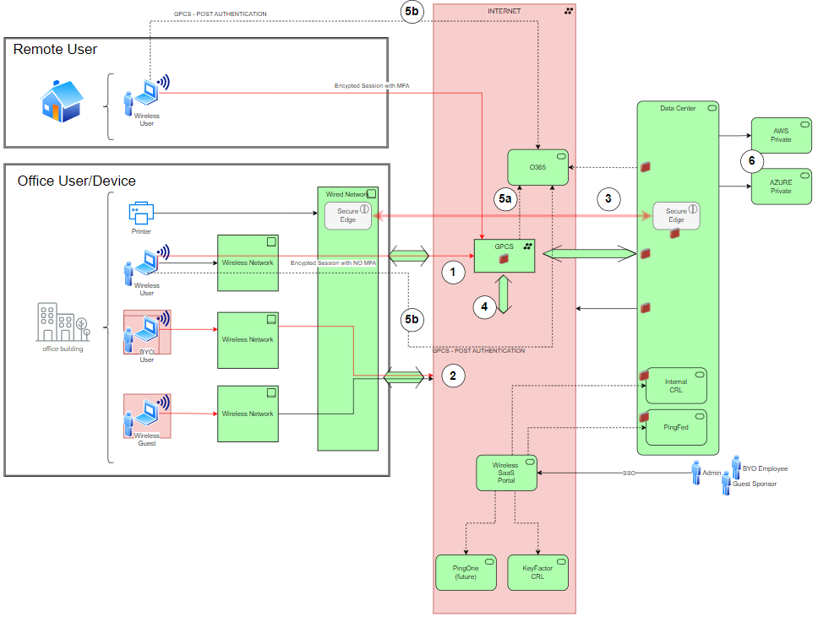
Original Architecture Diagram (UK Office)
The target solution at UK offices is to use wi-fi as the primary connectivity for all remote office users. The wi-fi network will be configured as a wi-fi hotspot, where the sole purpose of the wireless network is to provide access to the Internet.
From RITM-ACBSD-3160-New Office Experience

Slide 6
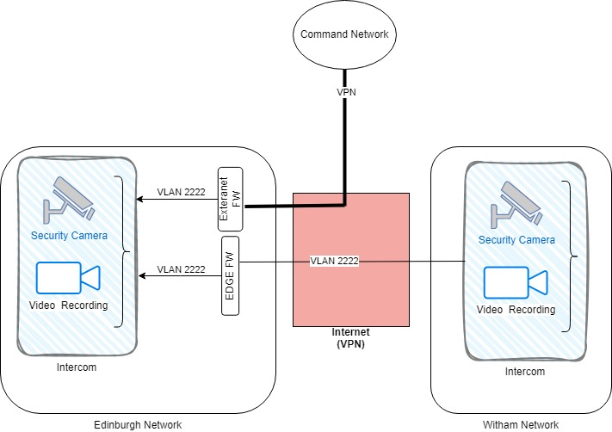
Design Pattern Architecture Diagram
A brief overview of the components and structure implemented by the design pattern
Network traffic for the Intercom equipment isolated from Aegon Network in a dedicated VLAN (VLAN ID=2222).
All new Intercom equipment are wired.
Communication with the vendor using standard VPN pattern.
Equipment include: Cameras, Video Handsets and IP I/O modules
Equipment locations: 37 in Edinburgh, 11 in Witham

Slide 7
Data Classification & Data Use Compliance
Approved DPIA. Initiated by AUK Ref# 11678
Data Classification |  | Data Legal and Regulatory Classification
☐ | Strictly Confidential | ☐ | Financial Information
☐ | Confidential | ☐ | Personal Identifiable Information
☐ | Internal | ☐ | Protected Health Information
☐ | Public | ☐ | Payment Card Information
☐ | No Data Shared | ☐ | No Personal Data Shared

Slide 8
Security and Compliance Controls & Configurations
Describe the Controls and Configurations required when implementing the design pattern
[Traffic Isolation – 1]
Requirement: Traffic isolation from Aegon Intranet
Configuration: Use a dedicated VLAN for the Intercom traffic isolated from Aegon Networks
[VPN Tunnel – 2]
Requirement: VPN tunnel for traffic encryption between the vendor and Aegon
Configuration: Setup standard VPN Tunnel following existing standard pattern (by GTS)

Slide 9
Exceptions
Architecture Alignment to Standards Score: <Enter Score>
Risk Acceptances
# | Acceptance Title | Exception Description | Link to Risk Exception Acceptance
1 | Wired connection for Intercom equipment | (Operational exception) Allow wired connectivity for intercom equipment in UK Edinburgh and Witham | N/A
2
3
4
5
6
7
Risk Remediations
# | Remediation Title | Exception Description | Link to Risk Remediation Acceptance
1
2
3
4
5
6
7
Notes Regarding Exceptions to Standards or Additional Concerns
Prior to an item being added to the ARB agenda for Design Pattern approval for risk acceptance or risk remediation must be obtained, not merely logged. Technology owner for the initiative is responsible for obtaining risk acceptance or risk mediation approvals.

Slide 10
Pattern Implementation & Operations Support Playbook
The Implementation Playbook defines the steps, ASK request ticket types, people or teams involved for implementation and operational support of components within the design pattern
Components | Provision & Implementation | Operation Support | ASK Request Ticket | GTS Contacts
VLAN setup | GTS | GTS |  | Quint, Mike
VPN setup | GTS | GTS | RITM1145587 | Michelle Marnock
Firewall Rules | GTS | GTS |  | Michelle Marnock
Intercom equipment installation | GTS | GTS |  | Quint, Mike

Slide 11

Questions?

Slide 12
End of presentation

